Slide 1
cs332 project : Distributed Sorting
Final Presentation
20190263 신재욱
20220615 고민석
20220170 하동은

Slide 2
Executing Commands
- Master
- Worker
sbt
runMain machine.Master [Number Of Workers]
sbt
runMain machine.Worker [MASTER_IP]:50051
-I [ABSOLUTE_PATH_OF_INPUT_DIRECTORIES]
-O [ABSOLUTE_PATH_OF_OUTPUTDIRECTORY]

Slide 3

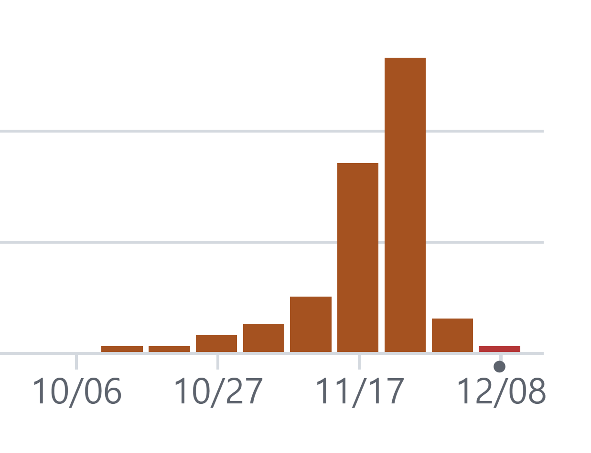
Test Result/Commits per week
 | Small Set | Big Set | Large Set
Execution Time (s) | 14 ~ 25 | 30 ~ 50 | 300 ~ 500
Correctness Check

Slide 4
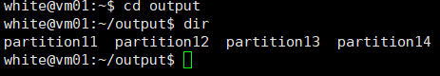
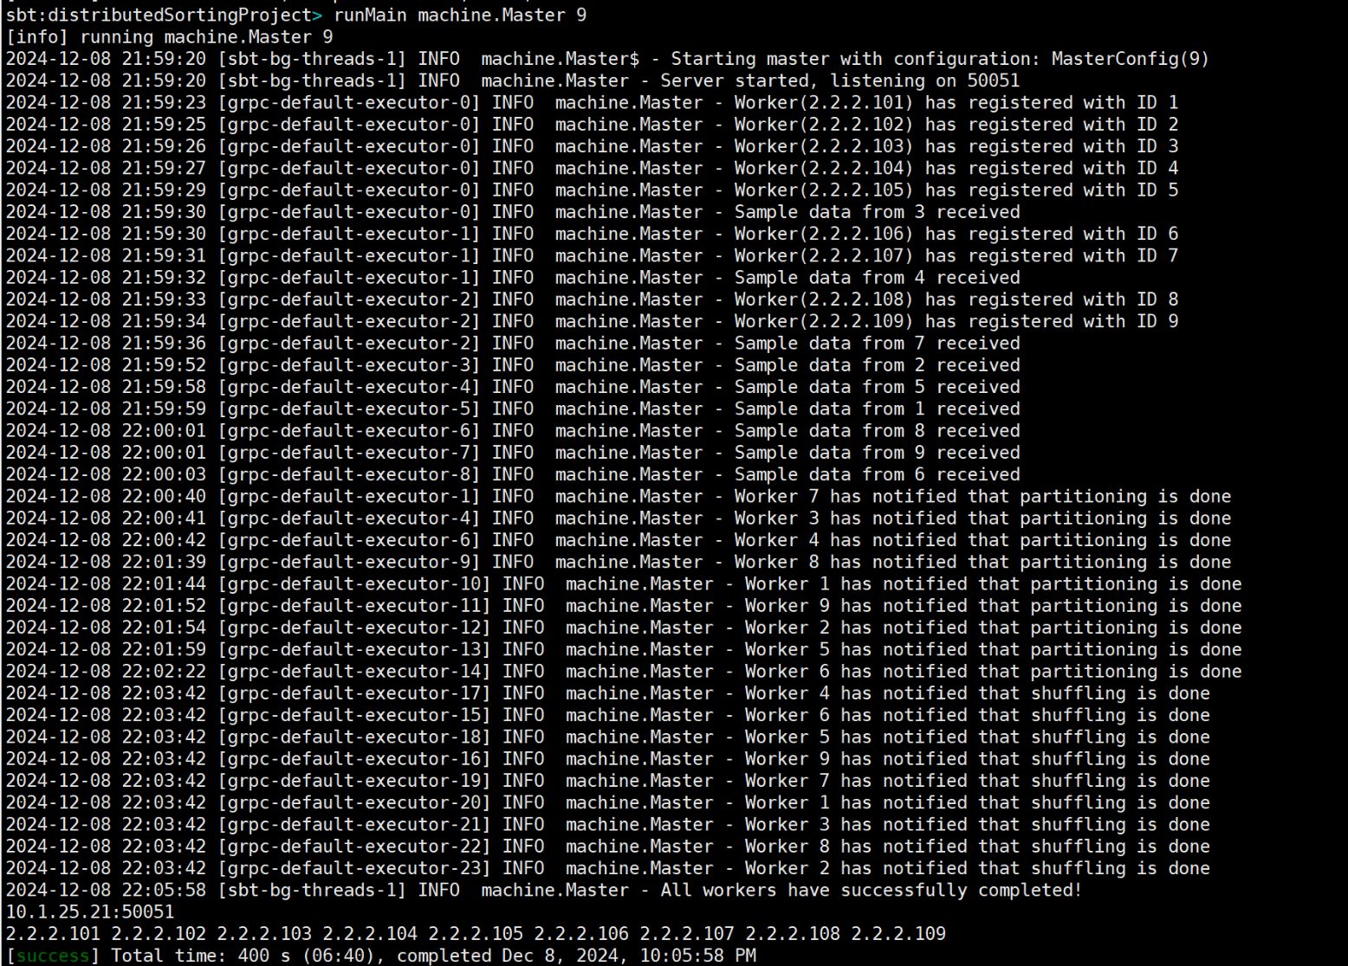
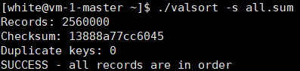
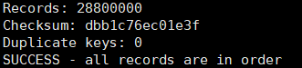

1. Output paths ?
2. Sorted ? | 3. # Input Record == #Output Record ?
small
big
large

Slide 5
Final architecture of your system (master/worker)
1. Registration
W( )
W(1)
W( )
Master
W(2)
W( )
W(3)
W( )
Worker IP
W(4)
# of Workers & Worker ID
2. Sampling & Pivot Calculation
W(1)
W(1)
W(2)
Master
W(2)
W(3)
W(3)
W(4)
Calculates the Pivot
W(4)
Worker ID & Sample Data
Partitioning Range & IP List

Slide 6
Final architecture of your system (master/worker)
3. Sorting & Partitioning
# of Workers
Data Chunk
(<= 100MB)
(1)
(2)
(3)
(n)
Data Chunk
(1)
(2)
(3)
.
.
.
(n)
Input FIles
Data Chunk
(1)
(2)
(3)
(n)
Data Chunk
(1)
(2)
(3)
(n)
READ
(concurrently)
Sort
Partition

Slide 7
Final architecture of your system (master/worker)
4. Shuffling
W(1)
5Future
W(1)
5Future
W(2)
5Future
W(2)
5Future
W(3)
5Future
W(3)
5Future
W(4)
5Future
W(1)
W(4)
5Future
W(6)
W(5)
5Future
W(2)
W(5)
5Future
W(7)
W(6)
5Future
W(3)
W(6)
5Future
W(8)
W(7)
5Future
W(4)
W(7)
5Future
W(9)
W(8)
5Future
W(5)
W(8)
5Future
W(10)
W(9)
5Future
W(9)
5Future
W(10)
5Future
W(10)
5Future

Slide 8
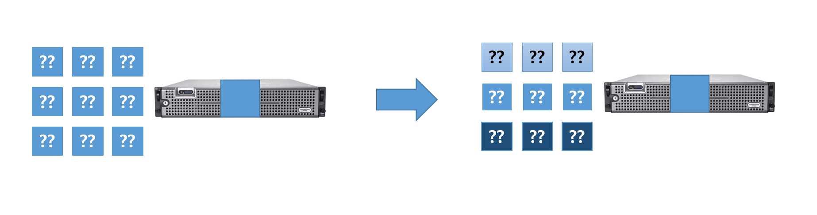
Final architecture of your system (master/worker)
5. Merging
(1)
(2)
(n)
1
2
3
4
W(1)
(1)
(2)
.
.
.
(n)
(1)
(2)
(n)
Partitioning
Merging
0.25 & 0.25 & 0.25 & 0.25

Slide 9
Overall progress
Week | Weekly Progress
1 | Define: Git Commit Convention / Coding Style / Meeting Schedule / Milestone
2 | Study: Project Scope / gRPC | Design: Overall Design / Use ChatGPT
3 | Study: gRPC | Design: Design Specific Functions
4 | Code: Server Setup / gRPC Examples / Message Protocol / Make Input Data
5 | Code: Sampling / Sort & Partition / Shell Scripts
6 | Code: Shuffling / Merge
7 | Code: Merge / Overall Test / Refactor Other Codes
8 | Test: Overall Test / Unit Test

Slide 10
Why your project was successful
Spending Enough Time
Meet Frequently to reduce communication overhead
Well Dividing Roles (Surgical Team Model)
Leader : Understand Overall, Assign Tasks, Overall Implements
Member : Focus on Specific Implementation
Lots of considerations in [Design Phase]

Slide 11
Lessons learned from the project
Time = Money
Surgical Team Model >> Democratic Model
Design Thoroughly Before Coding
Communicate with Your Team a Lot
Use ChatGPT Wisely -> Design Consulting, Implementation

